Slide 1
Lecture 8: Text Classification;
Vector space classification
[Borrows slides from Ray Mooney and Pandu Nayak and Prabhakar Raghavan]

Slide 2
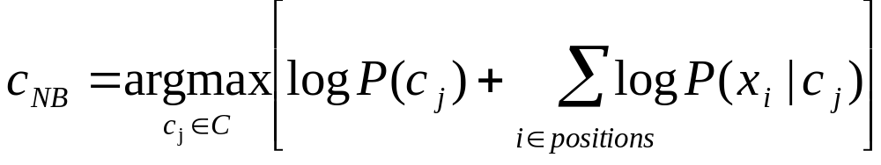
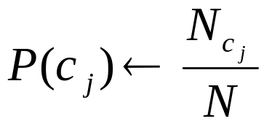
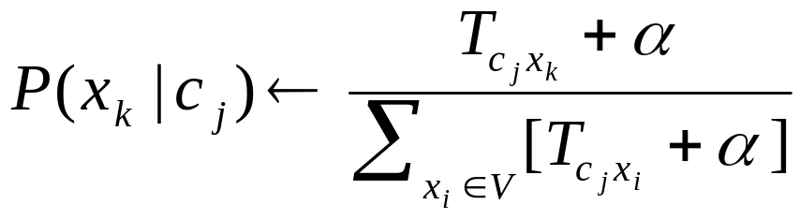
Recap: Naïve Bayes classifiers
Classify based on prior weight of class and conditional parameter for what each word says:
Training is done by counting and dividing:
Don’t forget to smooth

Slide 3
The rest of text classification
Today:
  Vector space methods for Text Classification
    Vector space classification using centroids (Rocchio)
    K Nearest Neighbors
    Decision boundaries, linear and nonlinear classifiers
    Dealing with more than 2 classes
Later in the course
  More text classification
    Support Vector Machines
    Text-specific issues in classification

Slide 4
Recall: Vector Space Representation
Sec.14.1
Each document is a vector, one component for each term (= word).
Normally normalize vectors to unit length.
High-dimensional vector space:
  Terms are axes
  10,000+ dimensions, or even 100,000+
  Docs are vectors in this space
How can we do classification in this space?

Slide 5
Classification Using Vector Spaces
Sec.14.1
As before, the training set is a set of documents, each labeled with its class (e.g., topic)
In vector space classification, this set corresponds to a labeled set of points (or, equivalently, vectors) in the vector space
Premise 1: Documents in the same class form a contiguous region of space
Premise 2: Documents from different classes don’t overlap (much)
We define surfaces to delineate classes in the space

Slide 6
Documents in a Vector Space
Sec.14.1
Government
Science
Arts

Slide 7
Test Document of what class?
Sec.14.1
Government
Science
Arts

Slide 8
Test Document = Government
Sec.14.1
Is this
similarity
hypothesis
true in
general?
Government
Science
Arts
Our main topic today is how to find good separators

Slide 9
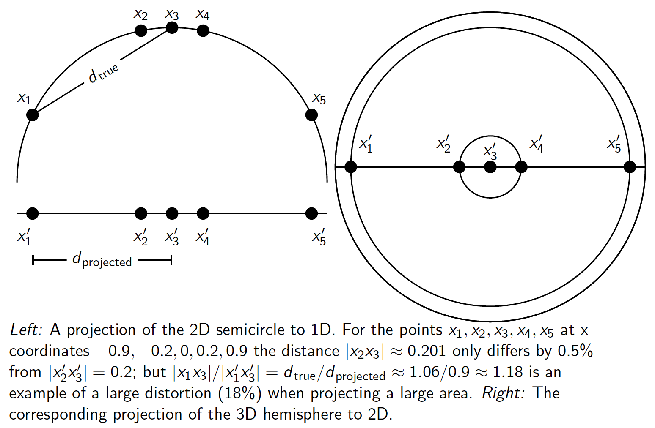
Aside: 2D/3D graphs can be misleading
Sec.14.1

Slide 10
Vector Space Classifiers
Based on a notation of distance
  Relatedness of documents is expressed by similarity/distance
We will use Euclidean distance
  correlation with cosine for unit vectors

Slide 11
Using Rocchio for text classification
Sec.14.2
Relevance feedback methods can be adapted for text categorization
  As noted before, relevance feedback can be viewed as 2-class classification
    Relevant vs. nonrelevant documents
Use standard tf-idf weighted vectors to represent text documents
For training documents in each category, compute a prototype vector by summing the vectors of the training documents in the category.
  Prototype = centroid of members of class
Assign test documents to the category with the closest prototype vector based on cosine similarity.

Slide 12
Illustration of Rocchio Text Categorization
Sec.14.2

Slide 13
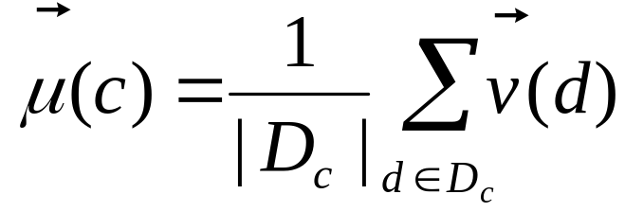
Definition of centroid
Sec.14.2
Where D_{c} is the set of all documents that belong to class c and v(d) is the vector space representation of d.
Note that centroid will in general not be a unit vector even when the inputs are unit vectors.

Slide 14
Rocchio Properties
Sec.14.2
Forms a simple generalization of the examples in each class (a prototype).
Prototype vector does not need to be averaged or otherwise normalized for length since cosine similarity is insensitive to vector length.
Classification is based on similarity to class prototypes.

Slide 15
Rocchio Anomaly
Sec.14.2
Prototype models have problems with polymorphic (disjunctive) categories.

Slide 16
Rocchio classification
Sec.14.2
Rocchio forms a simple representation for each class: the centroid/prototype
Classification is based on similarity to / distance from the prototype/centroid
It does not guarantee that classifications are consistent with the given training data
It is little used outside text classification
  It has been used quite effectively for text classification
  But in general worse than Naïve Bayes
Again, cheap to train and test documents

Slide 17
k Nearest Neighbor Classification
Sec.14.3
kNN = k Nearest Neighbor
To classify a document d into class c:
Define k-neighborhood N as k nearest neighbors of d
Count number of documents i in N that belong to c
Estimate P(c|d) as i/k
Choose as class argmax_{c} P(c|d) [ = majority class]

Slide 18
Example: k=6 (6NN)
Sec.14.3
P(science| )?
Government
Science
Arts

Slide 19
Nearest-Neighbor Learning Algorithm
Sec.14.3
Learning is just storing the representations of the training examples in D.
Testing instance x (under 1NN):
  Compute similarity between x and all examples in D.
  Assign x the category of the most similar example in D.
Does not explicitly compute a generalization or category prototypes.
Also called:
  Case-based learning
  Memory-based learning
  Lazy learning
Rationale of kNN: contiguity hypothesis

Slide 20
kNN Is Close to Optimal
Sec.14.3
Cover and Hart (1967)
Asymptotically, the error rate of 1-nearest-neighbor classification is less than twice the Bayes rate [error rate of classifier knowing model that generated data]
In particular, asymptotic error rate is 0 if Bayes rate is 0.
Assume: query point coincides with a training point.
Both query point and training point contribute error → 2 times Bayes rate

Slide 21
k Nearest Neighbor
Sec.14.3
Using only the closest example (1NN) to determine the class is subject to errors due to:
  A single atypical example.
  Noise (i.e., an error) in the category label of a single training example.
More robust alternative is to find the k most-similar examples and return the majority category of these k examples.
Value of k is typically odd to avoid ties; 3 and 5 are most common.

Slide 22
kNN decision boundaries
Sec.14.3
Boundaries are in principle arbitrary surfaces – but usually polyhedra
Government
Science
Arts
kNN gives locally defined decision boundaries between
classes – far away points do not influence each classification
decision (unlike in Naïve Bayes, Rocchio, etc.)
Notes:
Not hyperplane!

Slide 23
Similarity Metrics
Sec.14.3
Nearest neighbor method depends on a similarity (or distance) metric.
Simplest for continuous m-dimensional instance space is Euclidean distance.
Simplest for m-dimensional binary instance space is Hamming distance (number of feature values that differ).
For text, cosine similarity of tf-idf weighted vectors is typically most effective.

Slide 24
Illustration of 3 Nearest Neighbor for Text Vector Space
Sec.14.3

Slide 25
3 Nearest Neighbor vs. Rocchio
Nearest Neighbor tends to handle polymorphic categories better than Rocchio/NB.

Slide 26
Nearest Neighbor with Inverted Index
Sec.14.3
Naively, finding nearest neighbors requires a linear search through |D| documents in collection
But determining k nearest neighbors is the same as determining the k best retrievals using the test document as a query to a database of training documents.
Use standard vector space inverted index methods to find the k nearest neighbors.
Testing Time: O(B|V_{t}|) where B is the average number of training documents in which a test-document word appears.
  Typically B << |D|

Slide 27
kNN: Discussion
Sec.14.3
No feature selection necessary
Scales well with large number of classes
  Don’t need to train n classifiers for n classes
Classes can influence each other
  Small changes to one class can have ripple effect
Scores can be hard to convert to probabilities
No training necessary
  Actually: perhaps not true. (Data editing, etc.)
May be expensive at test time
In most cases it’s more accurate than NB or Rocchio

Slide 28
The bias-variance trade-off
Learning error = bias + variance
Bias – average error on multiple training sets (squared difference between actual probability and prediction)
  Characterize a flexibility of a classifier in separation between classes
Variance – variation of the prediction over different training sets (squared difference between prediction and avg prediction)
  Characterize a consistency of a classifier

Slide 29
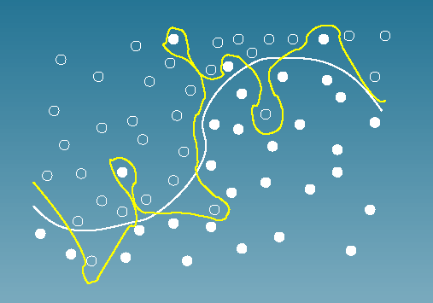
Bias vs. variance:
Choosing the correct model capacity
Sec.14.6
Tradeoff between bias and variance:
An algorithm with low bias must be "flexible" and can fit the data well.
But too flexible algorithm will fit each training data set differently,
and hence have high variance.

Slide 30
Linear vs. nonlinear classifiers
Sec.14.4
Consider 2 class problems (binary classification)
  Deciding between two classes, perhaps, government and non-government
    One-versus-rest classification
How do we define (and find) the separating surface?
How do we decide which region a test doc is in?

Slide 31
Separation by Hyperplanes
Sec.14.4
A strong high-bias assumption is linear separability:
  in 2 dimensions, can separate classes by a line
  in higher dimensions, need hyperplanes
Can find separating hyperplane by linear programming
  (or can iteratively fit solution via perceptron):
  separator can be expressed as ax + by = c

Slide 32
Linear programming
Sec.14.4
Find a,b,c, such that
ax + by > c for red points
ax + by < c for blue points.

Slide 33
Which Hyperplane?
Sec.14.4
In general, lots of possible
solutions for a,b,c.

Slide 34
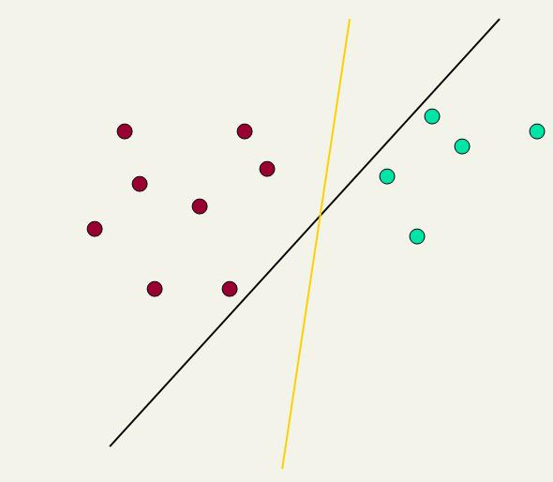
Which Hyperplane?
Sec.14.4
Lots of possible solutions for a,b,c.
Most methods find an optimal separating hyperplane
Which points should influence optimality?
  All points
    Linear/logistic regression
    Naïve Bayes
  Only “difficult points” close to decision boundary
    Support vector machines

Slide 35
Linear Classifiers
Sec.14.4
Many common text classifiers are linear classifiers
  Naïve Bayes
  Rocchio
  Logistic regression
  Support vector machines (with linear kernel)
  Linear regression
Despite this similarity, noticeable performance differences
  For separable problems, there is an infinite number of separating hyperplanes. Which one do you choose?
  What to do for non-separable problems?
  Different training methods pick different hyperplanes
Classifiers more powerful than linear often don’t perform better on text problems. Why?

Slide 36
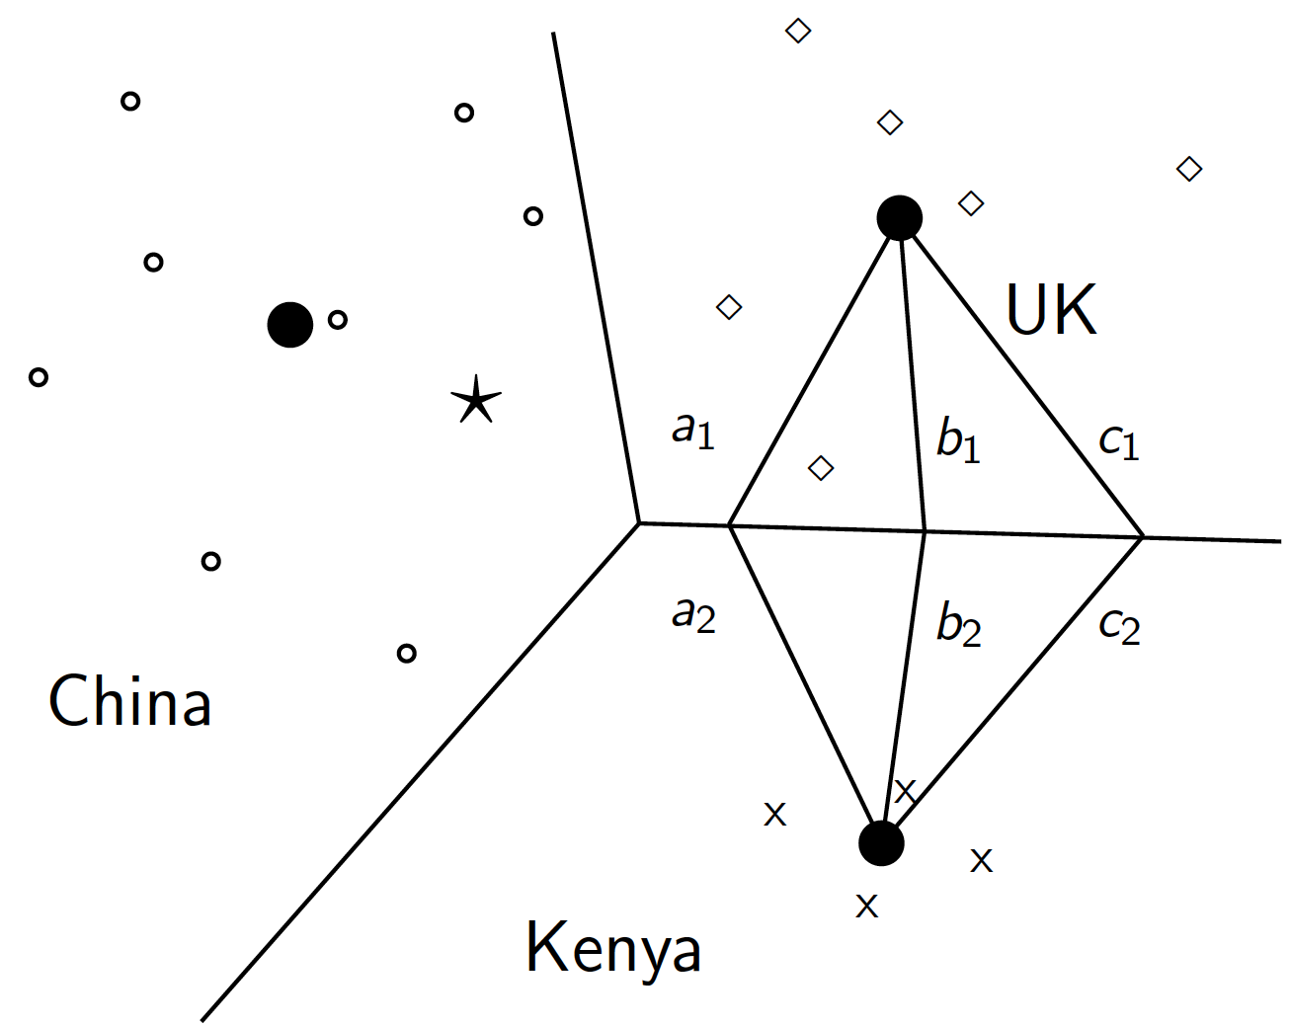
Rocchio is a linear classifier
Sec.14.2

Slide 37
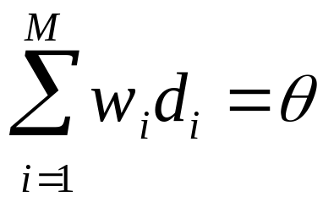
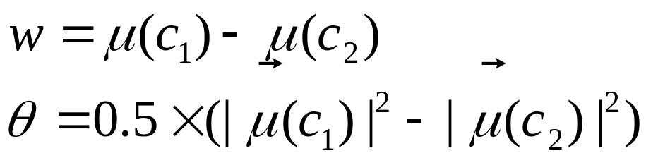
Two-class Rocchio as a linear classifier
Sec.14.2
Line or hyperplane defined by:
For Rocchio, set:

Slide 38
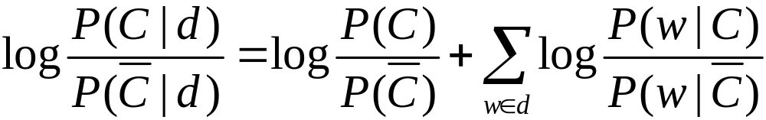
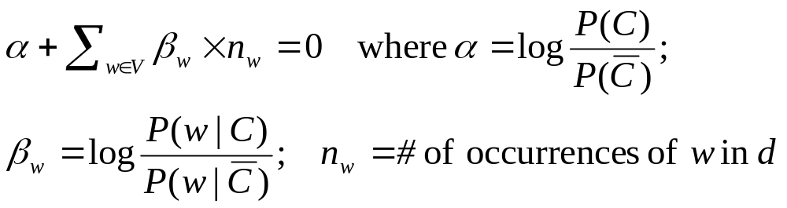
Naive Bayes is a linear classifier
Sec.14.4
Two-class Naive Bayes. We compute:
Decide class C if the odds is greater than 1, i.e., if the log odds is greater than 0.
So decision boundary is hyperplane:

Slide 39
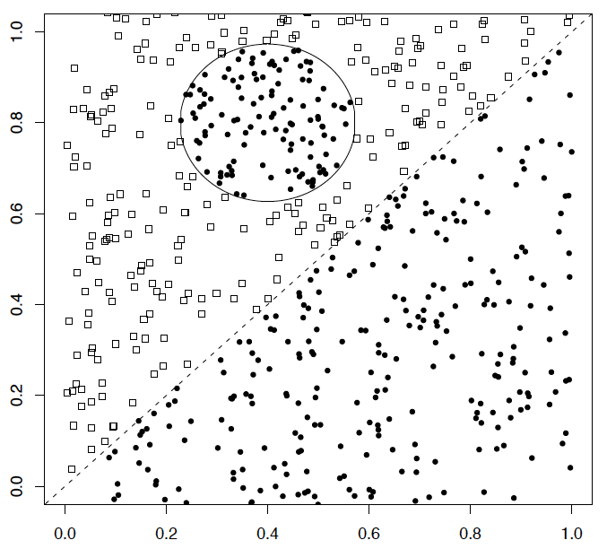
A nonlinear problem
Sec.14.4
A linear classifier like Naïve Bayes does badly on this task
kNN will do very well (assuming enough training data)

Slide 40
High Dimensional Data
Sec.14.4
Pictures like the one at right are absolutely misleading!
Documents are zero along almost all axes
Most document pairs are very far apart (i.e., not strictly orthogonal, but only share very common words and a few scattered others)
In classification terms: often document sets are separable, for most any classification
This is part of why linear classifiers are quite successful in this domain

Slide 41
kNN, NB, Rocchio
Linear: NB, Rocchio
Nonlinear: KNN

Slide 42
kNN vs. Naive Bayes and Rocchio
Sec.14.6
Bias/Variance tradeoff
kNN has high variance and low bias.
NB and Rocchio have low variance and high bias.
  Decision surface has to be linear (hyperplane)
High-variance learning methods are prone to overfitting
  Sensitive to a noise
Notes:
Bias/variance in terms of resulting classifier given randomly selected training set; why it is a tradeoff; when to choose low-bias method, when to choose low-variance method

Slide 43
More Than Two Classes
Sec.14.5
Any-of or multivalue classification
  Classes are independent of each other.
  A document can belong to 0, 1, or >1 classes.
  Decompose into n binary problems
  Quite common for documents
One-of or multinomial or polytomous classification
  Classes are mutually exclusive.
  Each document belongs to exactly one class
  E.g., digit recognition is polytomous classification
    Digits are mutually exclusive

Slide 44
Set of Binary Classifiers: Any of
Sec.14.5
Build a separator between each class and its complementary set (docs from all other classes)
  Train n classifiers (one for each class)
Given test doc, evaluate it for membership in each class.
  Apply each classifier separately
Done

Slide 45
Set of Binary Classifiers: One of
Sec.14.5
Build a separator between each class and its complementary set (docs from all other classes)
    Train n classifiers (one for each class)
Given test doc, evaluate it for membership in each class
    Apply each classifier separately
Assign document to class with:
  maximum score
  maximum confidence
  maximum probability
?
?
?

Slide 46
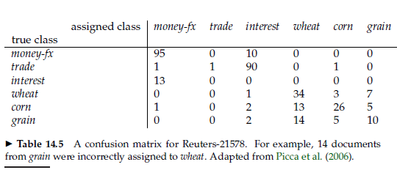
Confusion Matrix
Important tool for analysing the performance of a classifier for J > 2 classes
How it can help to improve the accuracy?
  Add features that distinguish wheat from grain documents

Slide 47
Summary: Representation of
Text Categorization Attributes
Representations of text are usually very high dimensional (one feature for each word)
High-bias algorithms that prevent overfitting in high-dimensional space should generally work best
For most text categorization tasks, there are many relevant features and many irrelevant ones
Methods that combine evidence from many or all features (e.g. naive Bayes, kNN) often tend to work better than ones that try to isolate just a few relevant features
Notes:
Explain supervised learning

Slide 48
Which classifier do I use for a given text classification problem?
Is there a learning method that is optimal for all text classification problems?
No, because there is a tradeoff between bias and variance.
Factors to take into account:
  How much training data is available?
  How simple/complex is the problem? (linear vs. nonlinear decision boundary)
  How noisy is the data?
  How stable is the problem over time?
    For an unstable problem, it’s better to use a simple and robust classifier.

Slide 49
Resources for today’s lecture
Ch. 14
IIR 14
Fabrizio Sebastiani. Machine Learning in Automated Text Categorization. ACM Computing Surveys, 34(1):1-47, 2002.
Yiming Yang & Xin Liu, A re-examination of text categorization methods. Proceedings of SIGIR, 1999.
Trevor Hastie, Robert Tibshirani and Jerome Friedman, Elements of Statistical Learning: Data Mining, Inference and Prediction. Springer-Verlag, New York.
Open Calais: Automatic Semantic Tagging
  Free (but they can keep your data), provided by Thompson/Reuters
Weka: A data mining software package that includes an implementation of many ML algorithms

